Slide 1
CPU软渲染 路径追踪渲染器
Path Tracing B站：HeaoYe

Slide 2

观看Games101
https://www.bilibili.com/video/BV1X7411F744?p=15
Lecture 15 Ray Tracing 3
https://www.bilibili.com/video/BV1X7411F744?p=16
Lecture 16 Ray Tracing 4

Slide 3
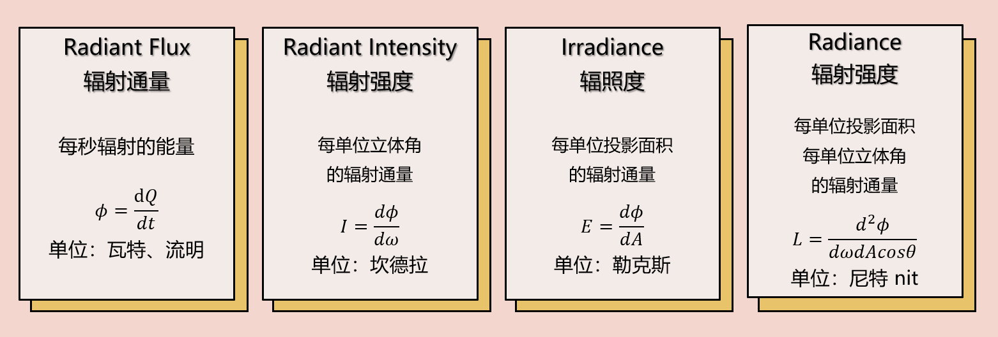
辐射度量学 Radiometry

Slide 4
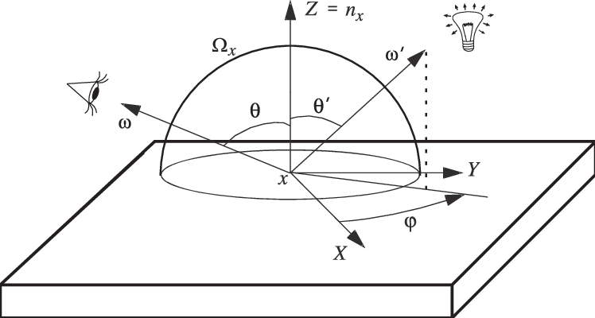
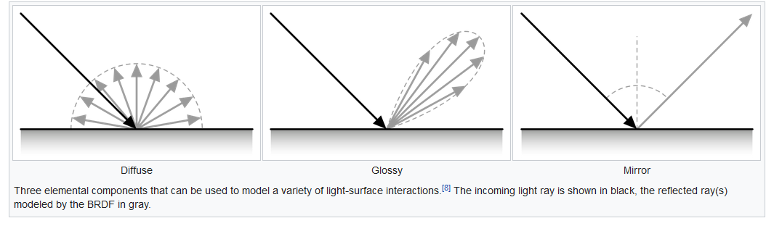
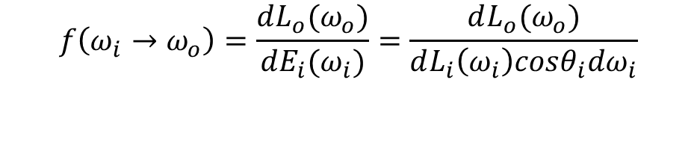
双向反射分布函数 BRDF
$$f\left(ω_{i}→ω_{o}\right)=\frac{dL_{o}(ω_{o})}{dE_{i}(ω_{i})}=\frac{dL_{o}(ω_{o})}{dL_{i}\left(ω_{i}\right)cosθ_{i}dω_{i}}$$

Slide 5
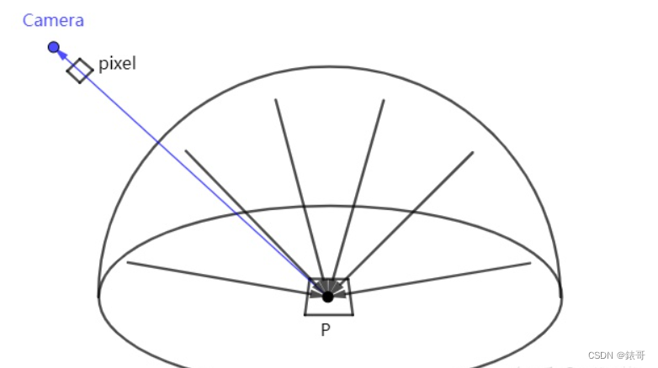


渲染方程 Rendering Equation
P点在$ω方向$的光线（Radiance）是多少？
$$L_{o}\left(p,ω_{o}\right)=\int_{H^{2}}^{ }{f\left(ω_{i}→ω_{o}\right)L_{i}\left(p,ω_{i}\right)|ω_{i}∙n|dω_{i}}$$
$$L_{o}\left({p,ω}_{o}\right)=L_{e}\left(p,ω_{o}\right)+\int_{H^{2}}^{ }{f\left(ω_{i}→ω_{o}\right)L_{i}\left(p,ω_{i}\right)|ω_{i}∙n|dω_{i}}$$
考虑自发光

Slide 6

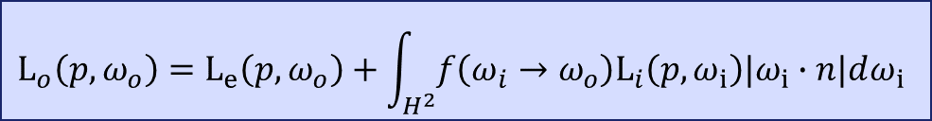

蒙特卡洛积分器 Monte Carlo Integration
$$\int_{D}^{ }{f\left(x\right)dx}=？ F_{N}=\frac{1}{N}\sum_{i=1}^{N}{\frac{f(X_{i})}{p(X_{i})}}$$
$随机变量X_{i}服从\text{概率密度} \text{p}\text{(}\text{x}\text{)}$，且x∈D
$$\text{E}\left(F_{N}\right)=E\left(\frac{1}{N}\sum_{i=1}^{N}{\frac{f\left(X_{i}\right)}{p\left(X_{i}\right)}}\right)$$
$$=\frac{1}{N}E\left(\sum_{i=1}^{N}{\frac{f\left(X_{i}\right)}{p\left(X_{i}\right)}}\right)$$
$$=\frac{1}{N}\sum_{i=1}^{N}{E\left(\frac{f\left(X_{i}\right)}{p\left(X_{i}\right)}\right)}$$
$$=\int_{D}^{ }{\frac{f\left(x\right)}{p\left(x\right)}p\left(x\right)dx}$$
$$=\int_{D}^{ }{f\left(x\right)dx}$$
$$L_{o}\left({p,ω}_{o}\right)=L_{e}\left(p,ω_{o}\right)+\int_{H^{2}}^{ }{f\left(ω_{i}→ω_{o}\right)L_{i}\left(p,ω_{i}\right)|ω_{i}∙n|dω_{i}}$$
$$根据p\left(ω\right)采样N个\text{入射方向}$$
$$记为： ω_{ik} k=1,2,3,……,N$$
$$\int_{H^{2}}^{ }{f\left(ω_{i}→ω_{o}\right)L_{i}\left(p,ω_{i}\right)|ω_{i}∙n|dω_{i}}$$
$$\frac{1}{N}\sum_{k=i}^{N}{\frac{f\left(ω_{ik}→ω_{o}\right)L_{i}\left(p,ω_{ik}\right)|ω_{ik}∙n|}{p\left(ω_{i}\right)}}$$
N = 1

Slide 7
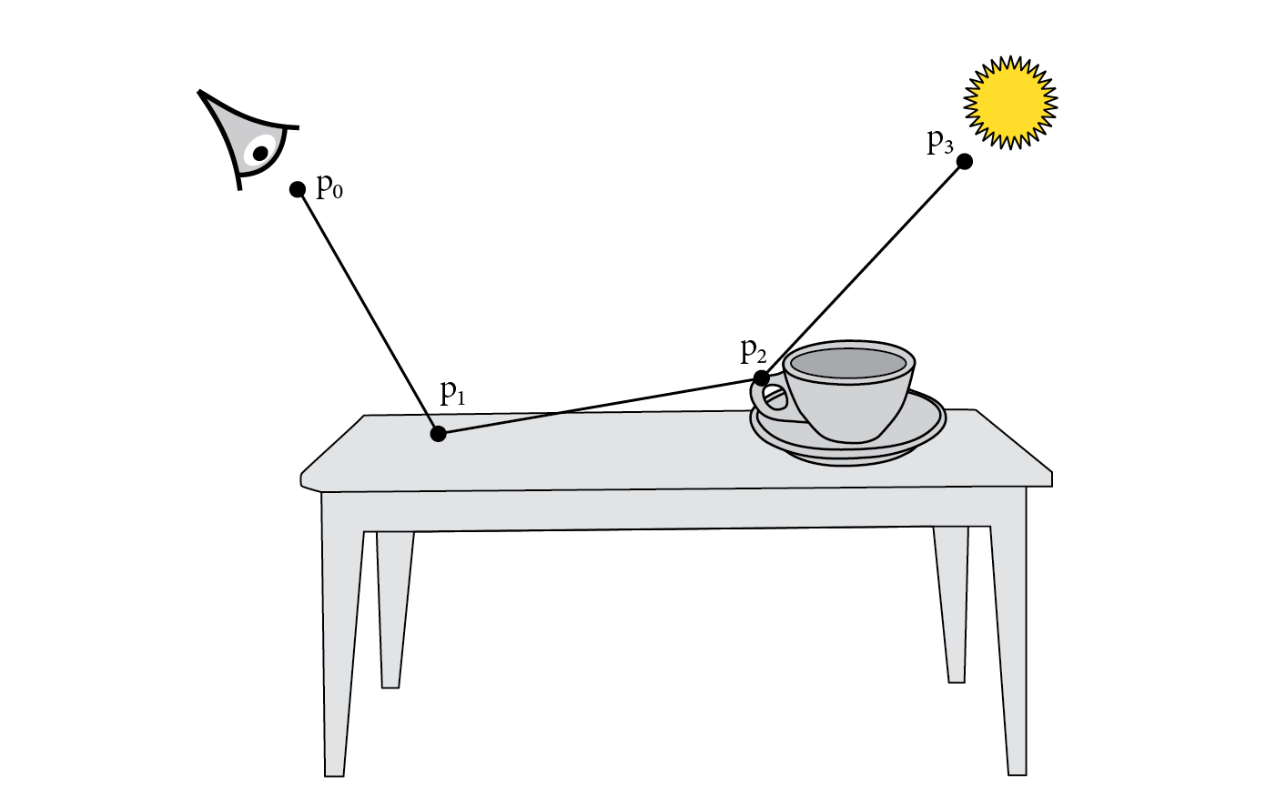
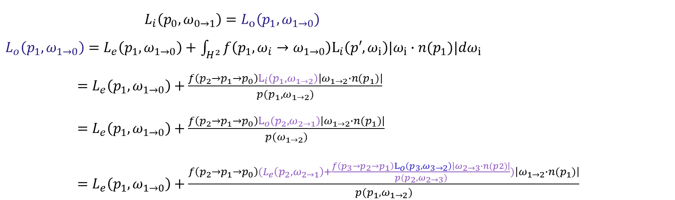
$L_{i}\left(p_{0}, ω_{0→1}\right)=L_{o}\left(p_{1},ω_{1→0}\right)$
$L_{o}\left(p_{1},ω_{1→0}\right)=L_{e}\left(p_{1},ω_{1→0}\right)+$ $\int_{H^{2}}^{ }{f\left({p_{1}, ω}_{i}→ω_{1→0}\right)L_{i}\left(p′,ω_{i}\right)|ω_{i}∙n(p_{1})|dω_{i}}$
$=L_{e}\left(p_{1},ω_{1→0}\right)+\frac{f\left(p_{2}→p_{1}→p_{0}\right)L_{i}\left(p_{1},ω_{1→2}\right)\left|ω_{1→2}∙n(p_{1})\right|}{p(p_{1}, ω_{1→2})}$
$=L_{e}\left(p_{1},ω_{1→0}\right)+\frac{f\left(p_{2}→p_{1}→p_{0}\right)L_{o}\left(p_{2},ω_{2→1}\right)\left|ω_{1→2}∙n(p_{1})\right|}{p(ω_{1→2})}$
$=L_{e}\left(p_{1},ω_{1→0}\right)+\frac{f\left(p_{2}→p_{1}→p_{0}\right)(L_{e}\left(p_{2},ω_{2→1}\right)+\frac{f\left(p_{3}→p_{2}→p_{1}\right)L_{o}\left(p_{3},ω_{3→2}\right)\left|ω_{2→3}∙n(p2)\right|}{p(p_{2},ω_{2→3})})\left|ω_{1→2}∙n(p_{1})\right|}{p(p_{1},ω_{1→2})}$

Slide 8

$$β_{i}=\left\{\begin{aligned}1, i=1 \\ \begin{aligned} \\ \\ \prod_{k=1}^{i−1}{\frac{f\left(p_{k+1},p_{k},p_{k−1}\right)|ω_{k→k+1}∙n(p_{k})|}{p(p_{k},ω_{k→k+1})}}, i>1\end{aligned}\end{aligned}\right.$$
$$L_{i}\left(p_{0}, ω_{0→1}\right)$$
$$=L_{e}\left(p_{1},ω_{1→0}\right)+ \int_{H^{2}}^{ }{f\left({p_{1}, ω}_{i}→ω_{1→0}\right)L_{i}\left(p′,ω_{i}\right)|ω_{i}∙n(p_{1})|dω_{i}}$$
$$=\sum_{i=1}^{+∞}{β_{i}∙L_{e}(p_{i},ω_{i→i−1})}$$

Slide 9


俄罗斯轮盘赌 Russian Roulette
$$已知蒙特卡洛积分器F_{N},且E\left(F_{N}\right)=\int_{D}^{ }{f\left(x\right)dx}$$
$$令：F_{N}^{′}=\left\{\begin{aligned}\frac{F_{N}}{q}, with prob q \\ 0, with prob 1−q\end{aligned}\right.$$
$$E\left(F_{N}^{′}\right)=q∗E\left(\frac{F_{N}}{q}\right)+\left(1−q\right)∗0$$
$$=E(F_{N})$$
$$L_{i}\left(p_{0}, ω_{0→1}\right)=\sum_{i=1}^{+∞}{β_{i}∙L_{e}(p_{i},ω_{i→i−1})}$$
应用结束概率为1-q的轮盘赌算法
$$L_{i}\left(p_{0}, ω_{0→1}\right)=\sum_{i=1}^{N}{\frac{β_{i}}{q^{i−1}}∙L_{e}(p_{i},ω_{i→i−1})}$$

Slide 10
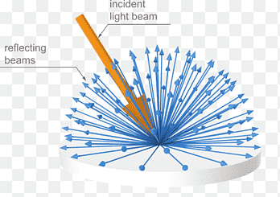

反照率 Albedo
$$反照率为ρ的表面的BRDF：$$
$$\int_{H^{2}(n)}^{ }{f\left(p,ω_{i}→ω_{o}\right)cosθdω_{o}}=\int_{0}^{2π}{\int_{0}^{\frac{π}{2}}{\frac{ρ}{π}cosθsinθdθ}dφ}=ρ$$
$$f\left(p\right)=\frac{ρ}{π}$$

Slide 11

镜面反射 Specular Reflection
$$f\left(p,ω_{i}→ω_{o}\right)=\frac{δ\left(ω−ω_{r}\right)ρ}{cosθ_{r}}$$
$$pdf\left(ω\right)=δ\left(ω−ω_{r}\right)$$
$$β_{i}=\left\{\begin{aligned}1, i=1 \\ \begin{aligned} \\ \\ \prod_{k=1}^{i−1}{\frac{f\left(p_{k+1},p_{k},p_{k−1}\right)|ω_{k→k+1}∙n(p_{k})|}{p(p_{k},ω_{k→k+1})}}, i>1\end{aligned}\end{aligned}\right.$$

Slide 12

余弦重要性采样 Cosine Importance Sampling
$$L_{o}\left({p,ω}_{o}\right)=L_{e}\left(p,ω_{o}\right)+\int_{H^{2}}^{ }{\frac{ρ}{π}L_{i}\left(p,ω_{i}\right)cosθdω_{i}}$$
$$pdf\left(ω\right)=\frac{1}{2π} → pdf\left(ω\right)∝\frac{ρ}{π}cosθ$$

Slide 13
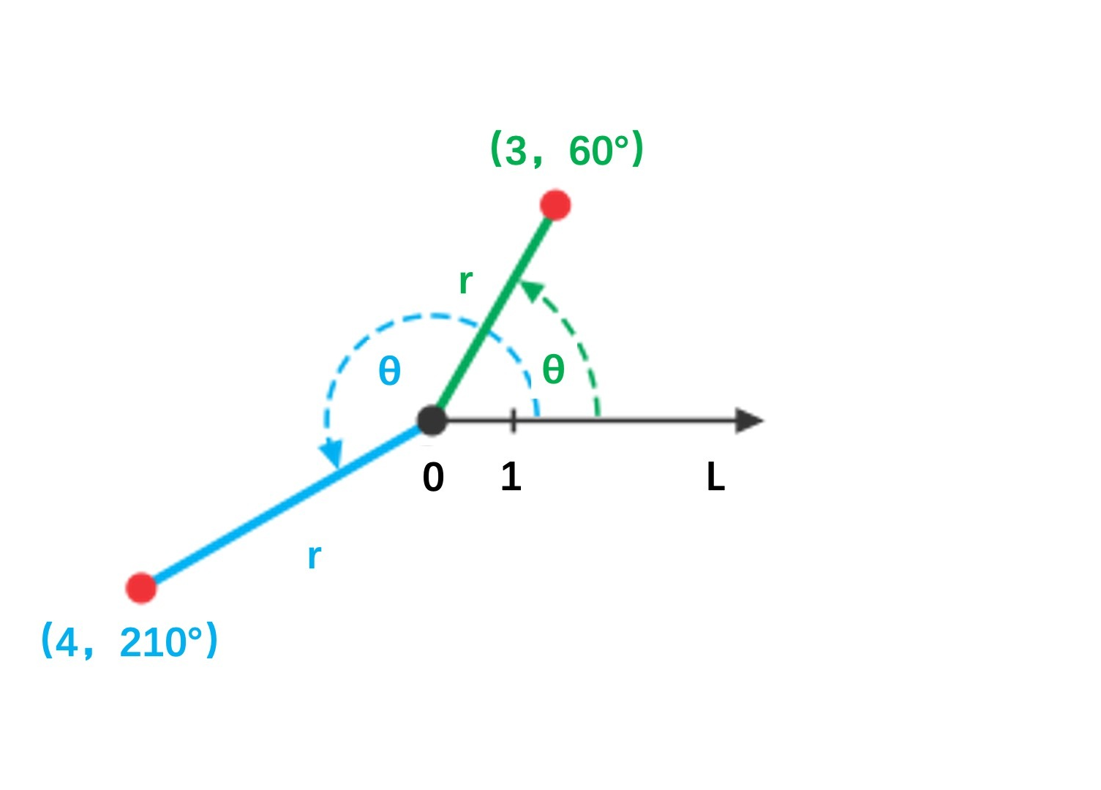

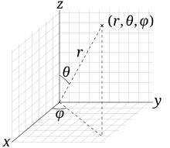

极坐标、球极坐标

Slide 14

概率密度单维度域的转换
随机变量X服从概率密度pdf(x)，函数y=f(x)
求随机变量Y=f(X)的概率密度？
$$cdf\left(x\right)=\int_{−∞}^{x}{pdf\left(x\right)dx}$$
$$P_{r}\left\{X≤x\right\}=P_{r}\left\{Y≤f(x)\right\}$$
$$cdf\left(x\right)=cdf\left(y\right)=cdf\left(f\left(x\right)\right)$$
$${[cdf\left(x\right)]}^{′}={[cdf(f\left(x\right))]}^{′}$$
$$pdf\left(x\right)=pdf\left(y\right)f^{′}\left(x\right)$$
$$pdf\left(y\right)=\frac{pdf\left(x\right)}{f^{′}\left(x\right)}$$

Slide 15
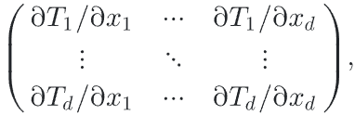

概率密度多维度域的转换
随机变量X服从概率密度pdf(x)，函数y=T(x)
求随机变量Y=T(X)的概率密度？
$$1 dims: pdf\left(y\right)=\frac{pdf\left(x\right)}{f^{′}\left(x\right)}$$
$$multidims: pdf\left(y\right)=\frac{pdf\left(x\right)}{|{ J}_{T}\left(x\right)|}$$

Slide 16

均匀采样圆盘 Sampling a Unit Disk
$$\iint{pdf\left(x,y\right)}dxdy=1, pdf\left(x,y\right)=\frac{1}{π}$$
$$pdf\left(r,θ\right)=？$$
$$T\left(r,θ\right)=\left(\begin{aligned}rcosθ \\ rsinθ\end{aligned}\right)$$
$${ J}_{T}\left(r,θ\right)=\left(\begin{matrix}\frac{∂x}{∂r} & \frac{∂x}{∂θ} \\ \frac{∂y}{∂r} & \frac{∂y}{∂θ}\end{matrix}\right)=\left(\begin{matrix}cosθ & −rsinθ \\ sinθ & rcosθ\end{matrix}\right), \left|{ J}_{T}\left(r,θ\right)\right|=r\left(\cos^{2}θ+\sin^{2}θ\right)=r$$
$$pdf\left(x,y\right)=\frac{pdf\left(r,θ\right)}{|{ J}_{T}\left(r,θ\right)|}, pdf\left(x,y\right)=\frac{pdf\left(r,θ\right)}{r}, pdf\left(r,θ\right)=\frac{r}{π}$$

Slide 17
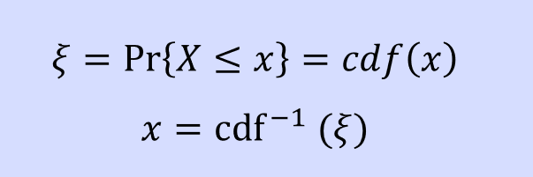
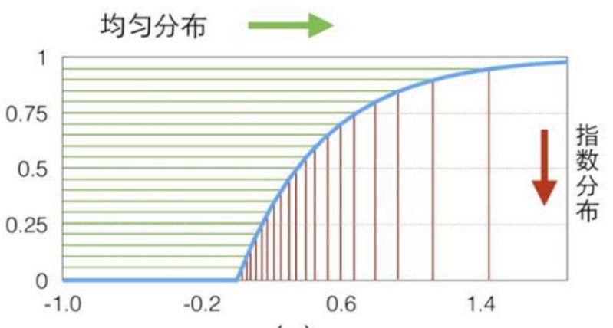

逆变换采样 Inversion Sampling

Slide 18


均匀采样圆盘 Sampling a Unit Disk
$$ξ=\operatorname{Pr}\left\{X≤x\right\}=cdf\left(x\right)$$
$$x={cdf}^{−1} (ξ)$$
$$pdf\left(r,θ\right)=\frac{r}{π}$$
$$pdf\left(r\right)=\int_{0}^{2π}{pdf\left(r,θ\right)dθ}=2r$$
$$pdf\left(θ | r\right)=\frac{pdf(θ,r)}{pdf(r)}=\frac{1}{2π}$$
$$cdf\left(r\right)=\int{2rdr}=r^{2}$$
$$cdf\left(θ | r\right)=\int{\frac{1}{2π}dθ}=\frac{θ}{2π}$$
$$ξ_{1}=cdf\left(r\right)=r^{2}$$
$$r=\sqrt{ξ_{1}}$$
$$ξ_{2}=cdf\left(θ | r\right)=\frac{θ}{2π}$$
$$θ=2πξ_{2}$$

Slide 19

余弦重要性采样 Cosine Importance Sampling
$$pdf\left(ω\right)∝cosθ, pdf\left(ω\right)=c∙cosθ, \int_{H^{2}}^{ }{pdf\left(ω\right)dω}=1$$
$$\int_{0}^{2π}{\int_{0}^{\frac{π}{2}}{c∙cosθsinθdθ}dφ}=1, 2πc\int_{0}^{\frac{π}{2}}{cosθsinθdθ}=1, c=\frac{1}{π}$$
$$pdf\left(θ,φ\right)=c∙cosθsinθ=\frac{cosθsinθ}{π}$$

Slide 20
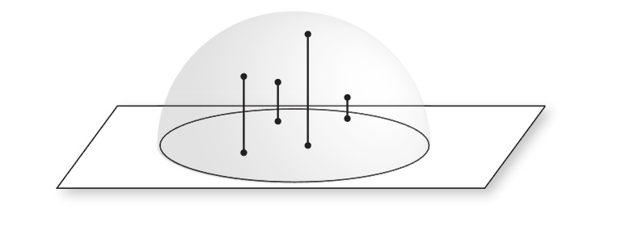
马利方法 Malley’s Method
1.均匀采样圆盘
2.将采样点垂直映射到半球上

Slide 21

余弦重要性采样 Cosine Importance Sampling
$$pdf\left(r,θ\right)=\frac{r}{π}, pdf\left(r,φ\right)=\frac{r}{π}, pdf\left(θ,φ\right)=？$$
$$T\left(θ,φ\right)=\left(\begin{aligned}sinθ \\ φ\end{aligned}\right)$$
$${ J}_{T}\left(θ,φ\right)=\left(\begin{matrix}\frac{∂r}{∂θ} & \frac{∂r}{∂φ} \\ \frac{∂φ}{∂θ} & \frac{∂φ}{∂φ}\end{matrix}\right)=\left(\begin{matrix}cosθ & 0 \\ 0 & 1\end{matrix}\right), \left|{ J}_{T}\left(θ,φ\right)\right|=cosθ$$
$$pdf\left(r,φ\right)=\frac{pdf\left(θ,φ\right)}{|{ J}_{T}\left(θ,φ\right)|}, pdf\left(r,φ\right)=\frac{pdf\left(θ,φ\right)}{cosθ}, pdf\left(θ,φ\right)=\frac{rcosθ}{π}=\frac{sinθcosθ}{π}$$

